Slide 1
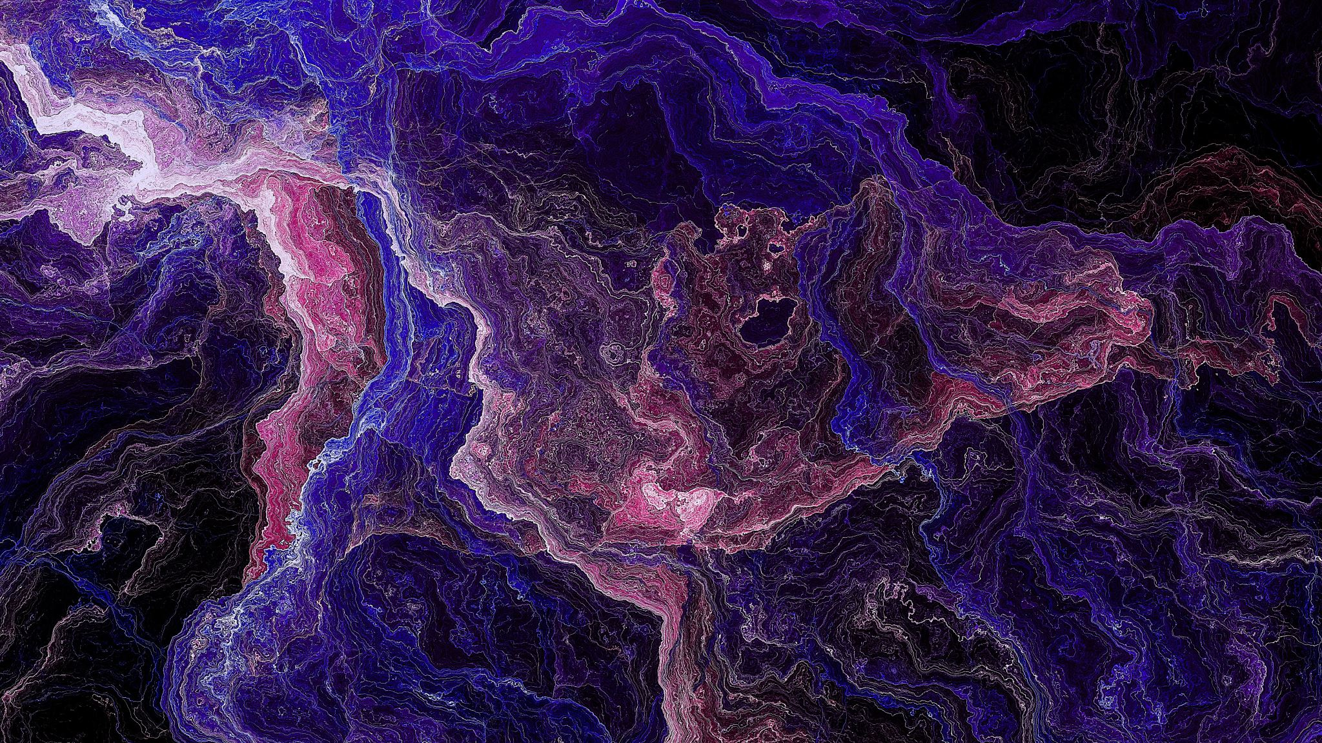
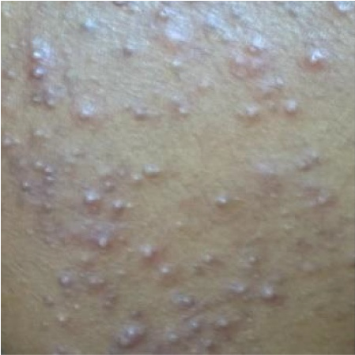
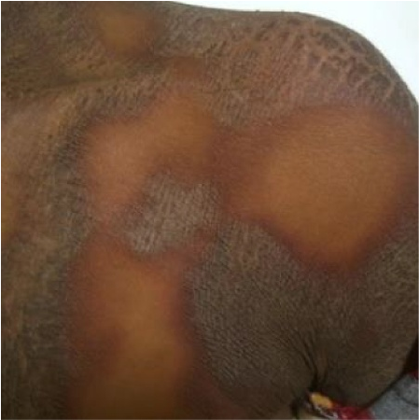
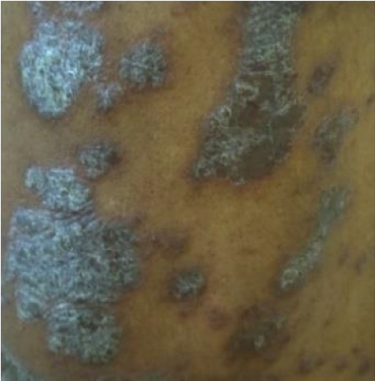
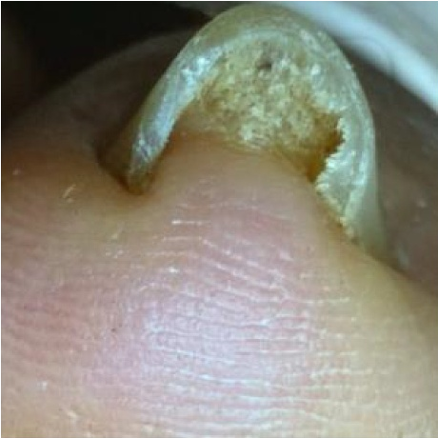
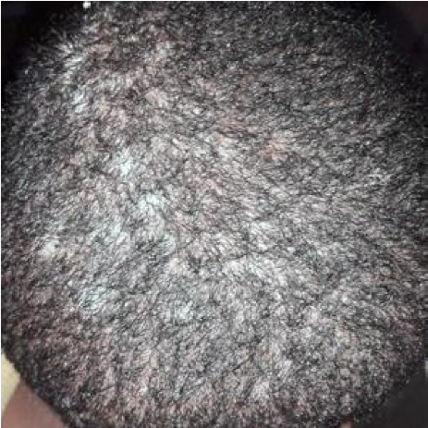
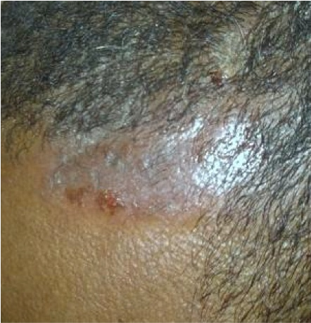
Automatic skin disease diagnosis using deep learning from clinical image and patient information
NAME : Rishitha Reddy Likki
Id : 700748512
Video link :
https://drive.google.com/drive/my-drive

Slide 2
MOTIVATION :
Skin diseases are the fourth most common cause of human illness which results in enormous non‐fatal burden in daily life activities. They are caused by chemical, physical and biological factors. Visual assessment in combination with clinical information is the common diagnostic procedure for diseases. However, these procedures are manual, time‐consuming, and require experience and excellent visual perception.

Slide 3
BACK GROUND OF PROBLEM
Skin Cancer: Most Predominant type of cancer.
The Frequency of Melanoma Doubles 20 years Each Year in the USA
Melanoma is a Deadly form of Skin Cancer, but survival rates are very high if it diagnosed in the Early stages
Melanoma detection: rely on Handcrafted Features
Based on Two Cases: 1) ABCDE ( Asymmetric, Border, Color, Dermoscopic, and Evolving )
2) CASH (Colour, Architecture Symmetric Homogeneity )

Slide 4

Deep Learning Motivation
Image Classification
Object Detection and Recognization
Semantic Segmentation

Slide 5
IMAGE CLASSIFICATION
Image Classification is probably the most important part of digital image analysis. It Uses AI Based deep learning models to analyze images with results that for specific tasks already surpass human-level accuracy
If We go for Example our Mobile phones which detect our Faces to unlock our mobile

Slide 6
Object Detection and Recognization
Object Detection Using Deep Learning Provides a Fast and Accurate means to Predict the location of an object in an image.
Deep learning is a powerful machine learning technique in which the object detector automatically learns image features required for detection tasks .
Navigation Assistance in Google Maps would be the best example for this.

Slide 7
Semantic Segmentation
Image parsing using deep learning is done through the extraction of the component features and representations of the image. So, inherently, semantic segmentation facilitates image processing through the removal of noise from the image and deriving meaningful correlations between the pixels of the image
Self Driving Cars are on of the example for Semantic Segmentation

Slide 8
MATERIALS AND METHOD
Input image
Pre-process
Augmentation
MobileNet-v2
This automated diagnosis system was developed by using a pre‐trained mobilenet‐v2 model. Both skin images and patient clinical information were preprocessed and concatenated for classification of skin diseases. Figure demonstrates the general block diagram of the proposed system.
Dense layer
Assessment
Pre-process
Concatenation
128
Neuron
SoftMax-Classifier

Slide 9
Evaluating Result:
First, an image of the contaminated region of their skin is taken. The pictures of illness will be handled by the model and it will classify the skin disease if it matches one of the five skin diseases on which it was trained. Our evaluation metrics will be accuracy, f1 score, recall, and precision. As this is the classification task we will consider the confusion matrix for the model used in the implementation.

Slide 10
References:
[1]. Goceri, E. (2019). Skin disease diagnosis from photographs using deep learning. In VipIMAGE 2019: Proceedings of the VII ECCOMAS Thematic Conference on Computational Vision and Medical Image Processing, October 16–18, 2019, Porto, Portugal (pp. 239-246). Springer International Publishing.
[2]. Li, H., Pan, Y., Zhao, J., & Zhang, L. (2021). Skin disease diagnosis with deep learning: a review. Neurocomputing, 464, 364-393.
[3]. Inthiyaz, S., Altahan, B. R., Ahammad, S. H., Rajesh, V., Kalangi, R. R., Smirani, L. K., ... & Rashed, A. N. Z. (2023). Skin disease detection using deep learning. Advances in Engineering Software, 175, 103361.
[4]. Li, L. F., Wang, X., Hu, W. J., Xiong, N. N., Du, Y. X., & Li, B. S. (2020).
Deep learning in skin disease image recognition: A review. IEEE Access, 8, 208264-208280.
[5]. Kumar, V. B., Kumar, S. S., & Saboo, V. (2016, September). Dermatological disease detection using image processing and machine learning. In 2016 Third
International Conference on Artificial Intelligence and Pattern Recognition (AIPR)
(pp. 1-6). IEEE.
[6]. Anand, V., Gupta, S., & Koundal, D. (2022). Skin disease diagnosis: challenges and opportunities. In Proceedings of Second Doctoral Symposium on Computational Intelligence: DoSCI 2021 (pp. 449-459). Springer Singapore.
[7]. Rathod, J., Waghmode, V., Sodha, A., & Bhavathankar, P. (2018, March). Diagnosis of skin diseases using Convolutional Neural Networks. In 2018 second international conference on electronics, communication and aerospace technology (ICECA) (pp. 1048-1051). IEEE.
[8]. Rimi, T. A., Sultana, N., & Foysal, M. F. A. (2020, May). Derm-NN: skin diseases detection using convolutional neural network. In 2020 4th International Conference on Intelligent Computing and Control Systems (ICICCS) (pp. 1205-1209). IEEE.

